Slide 1
Week 7
Querying in Non-Relational Databases

Slide 2
Lesson 9
The Mongo Query Language

Slide 3
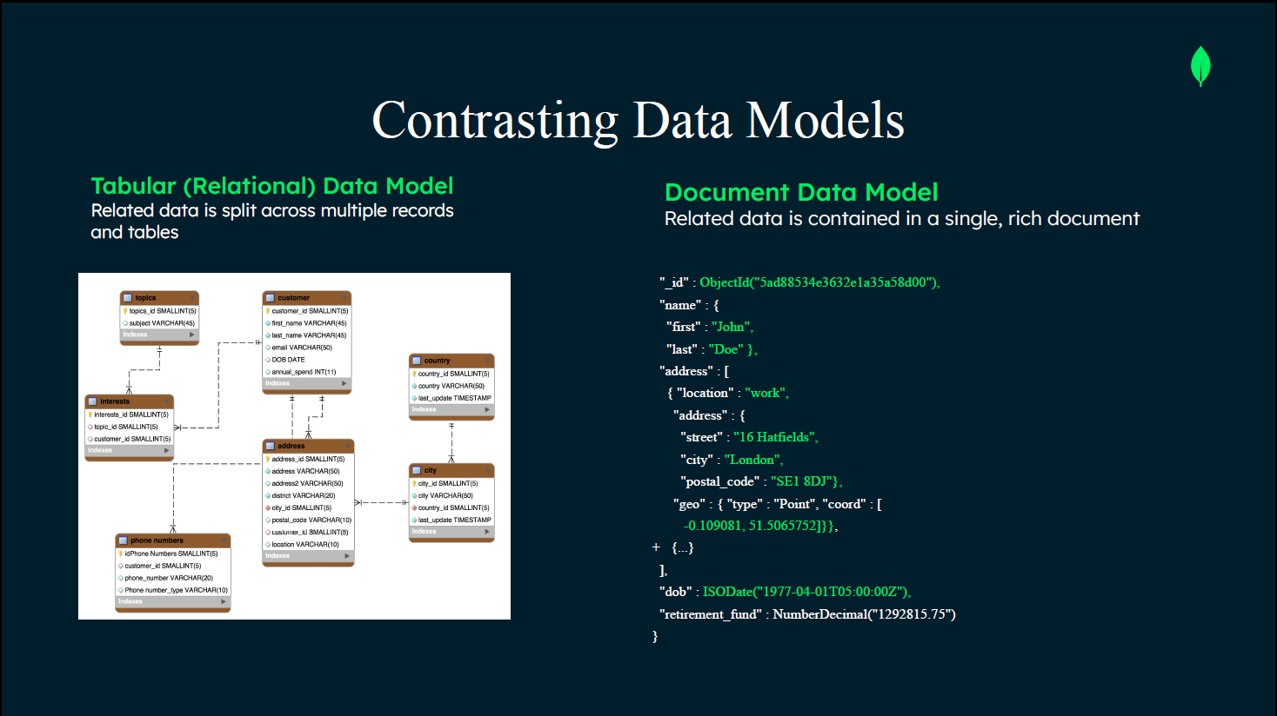

Slide 4
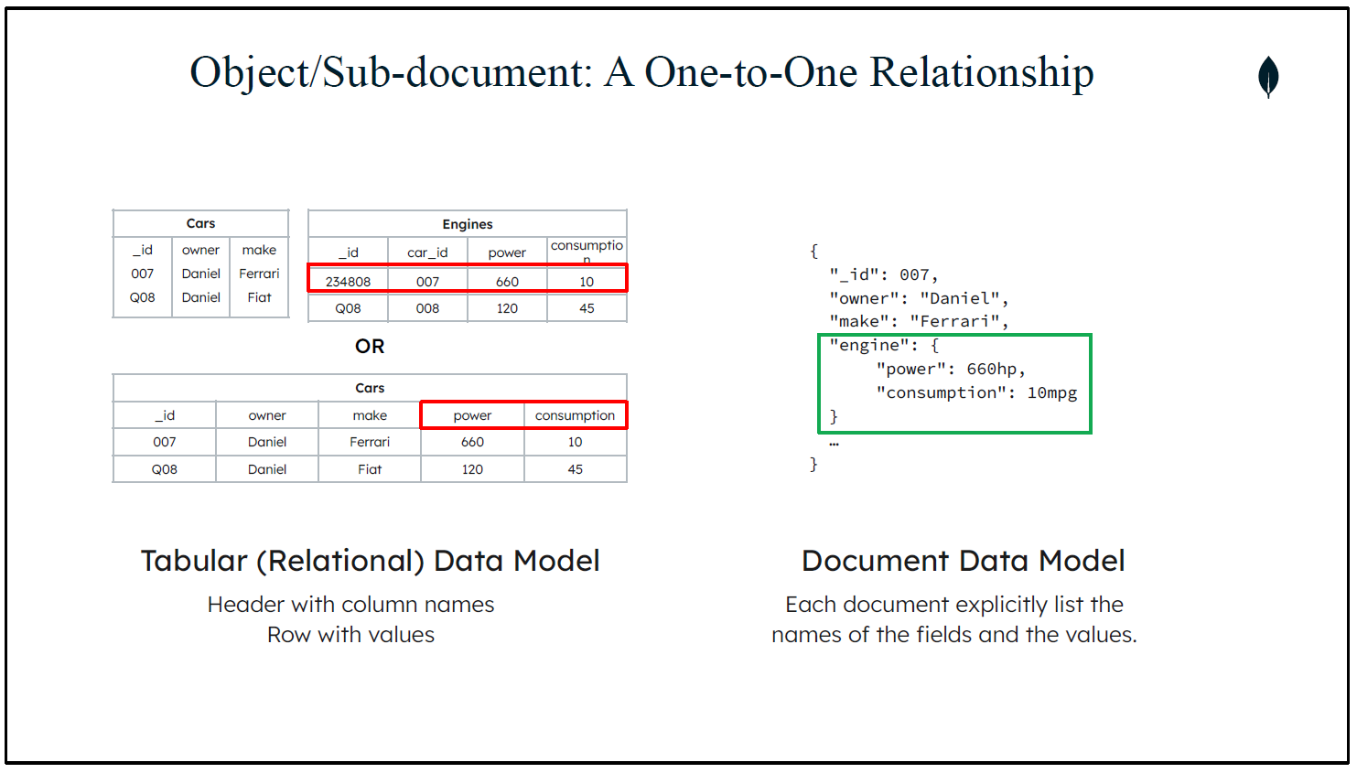

Slide 5
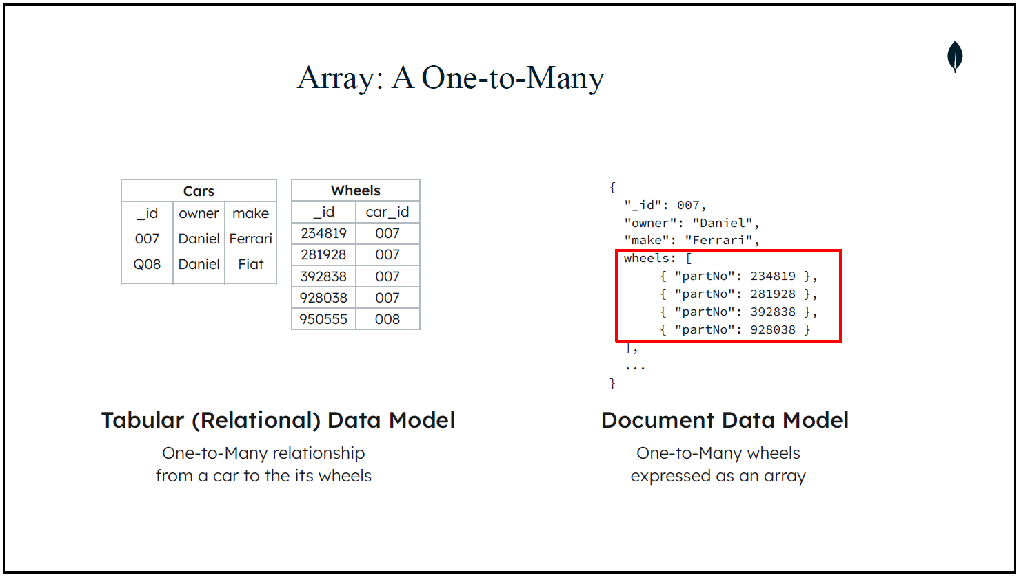

Slide 6
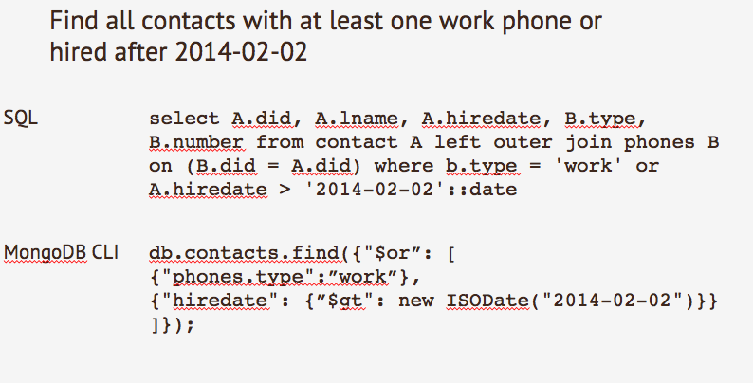
MQL
Mongo Query Language
Imperative language designed to query documents
Use to query SINGLE collections
MongoDB Aggregation Framework
Designed for aggregations
Complex operations broken into stages which can help isolate errors
Can be hard for SQL folks to learn and adapt to

Slide 7
Lesson 10
The Mongo Query Language

Slide 8
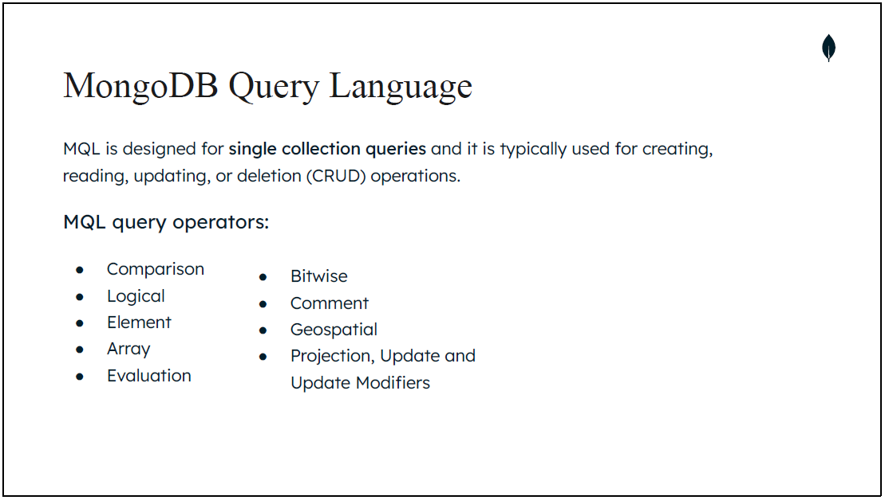

Slide 9
MQL Find
Similar to the SQL WHERE condition
Returns all fields in the document(s)
Does not perform a PROJECT (SELECT in SQL)
In the query filter document you can also use query operators to specify specific conditions like defining a range or exact match for the value(s) you want to limit your query to return.
db.<collection>.find({ <field1>: { <operator1>: <value1> }, ... });
db.student.find({ age : { $gt : 30, $lt : 60}});
db.students.find({$and:[{u1:{$gt:30}},{u1:{$lt:60}}]});

Slide 10
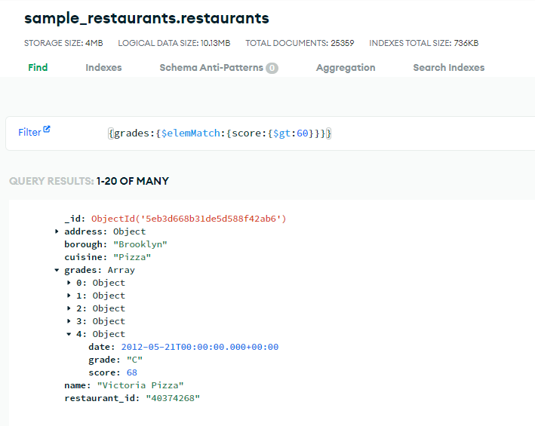
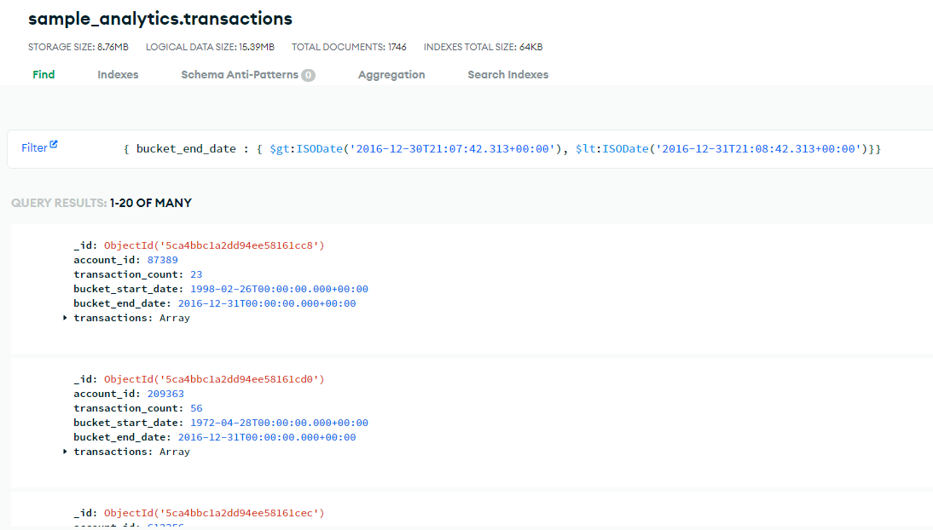
Examples
Array Element Matching
Between Two Dates

Slide 11
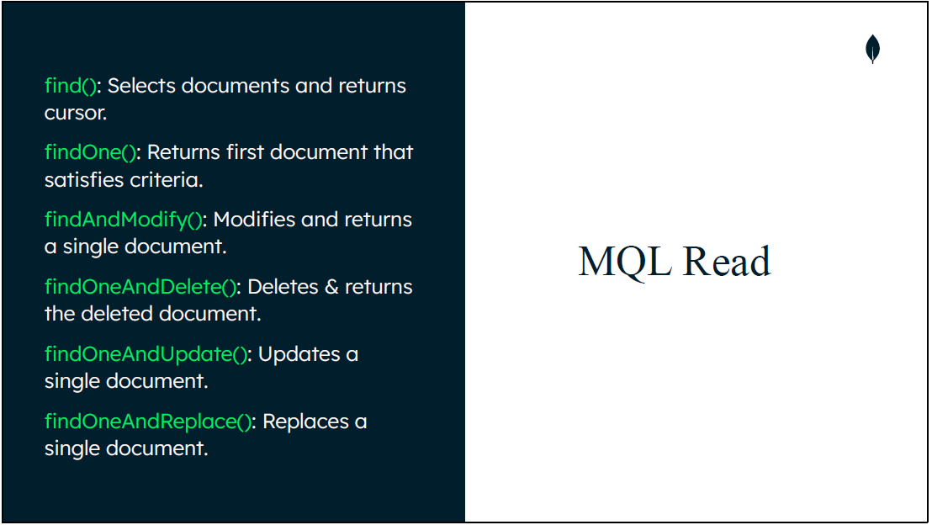
CRUD Operations

Slide 12
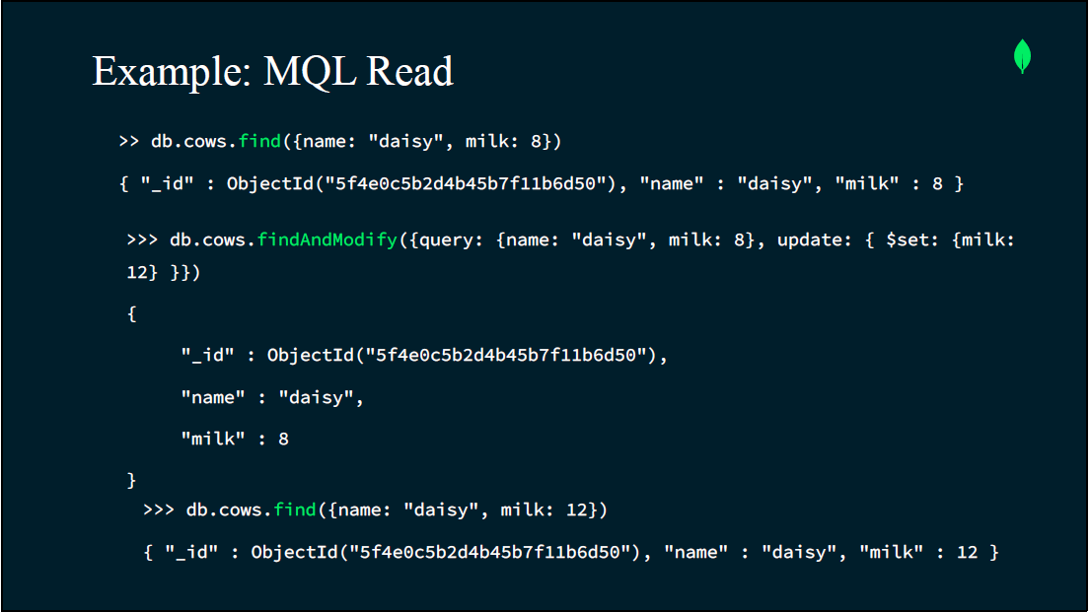

Slide 13
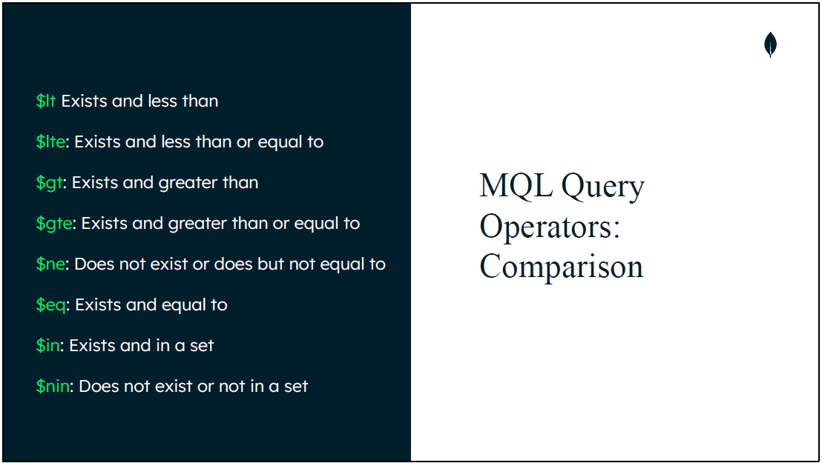

Slide 14
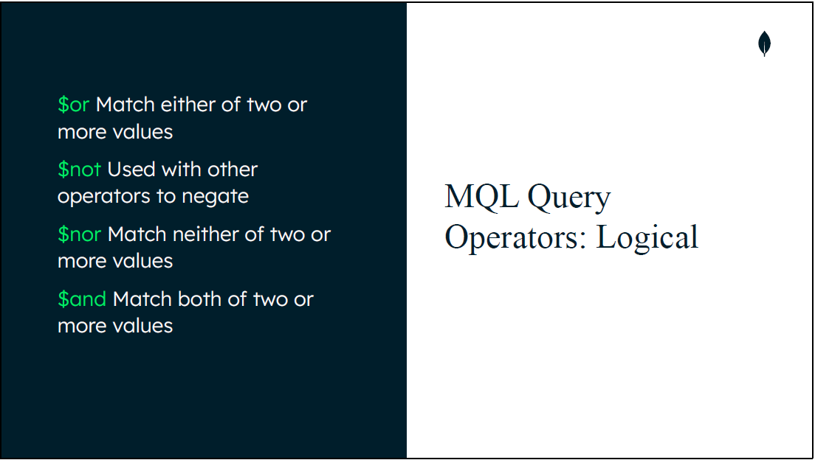

Slide 15
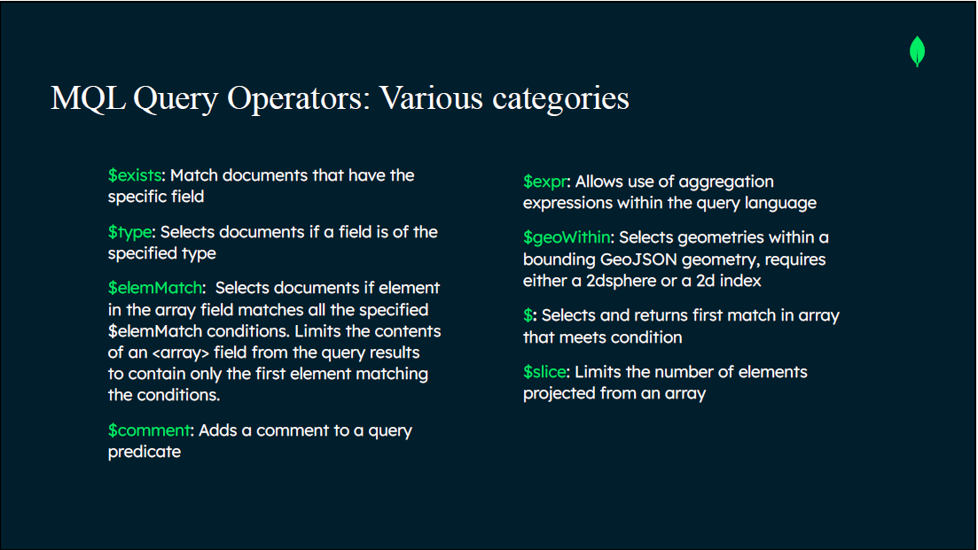

Slide 16
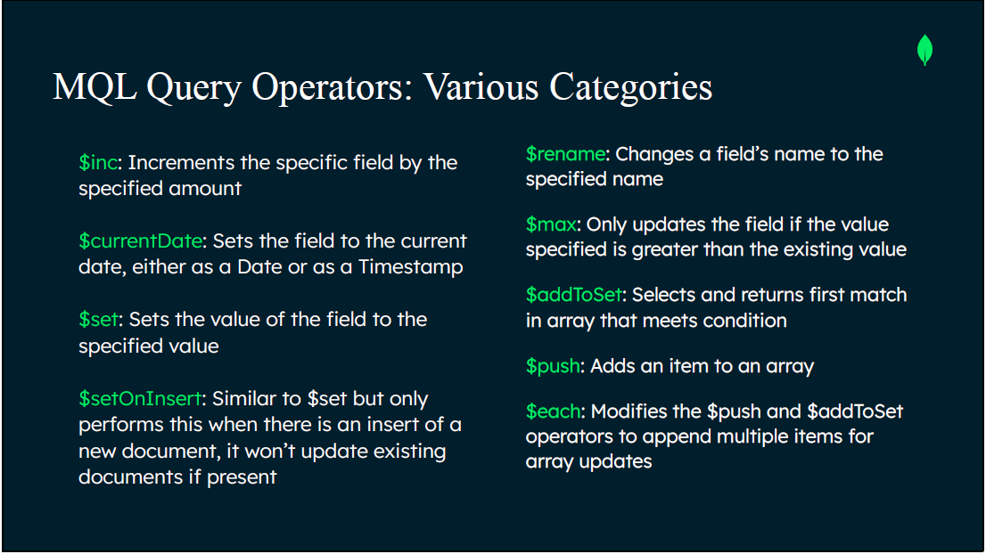

Slide 17
Lesson 11
Querying Complex Data

Slide 18
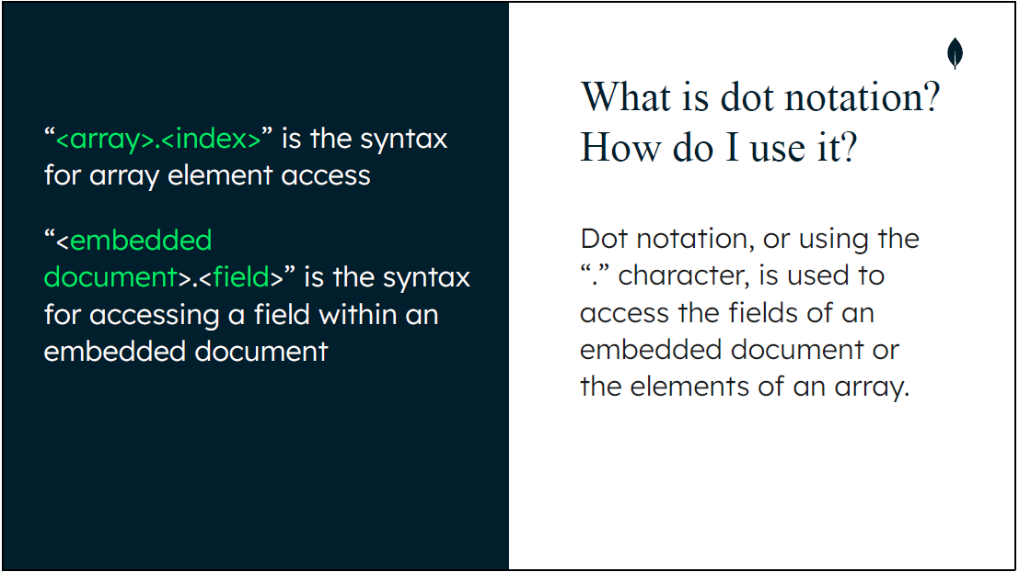
Notes:
Embedding increases read performance. Instead of querying multiple collections or documents you can query a single document for related data.

Slide 19
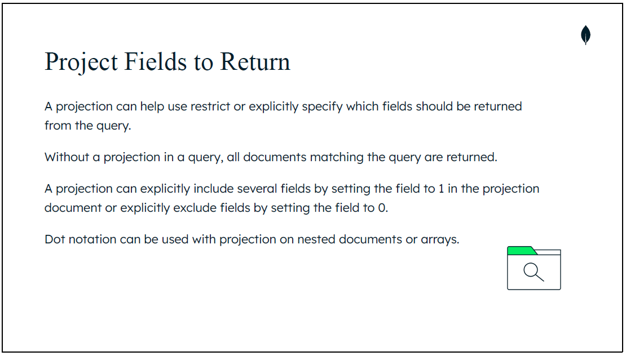

Slide 20
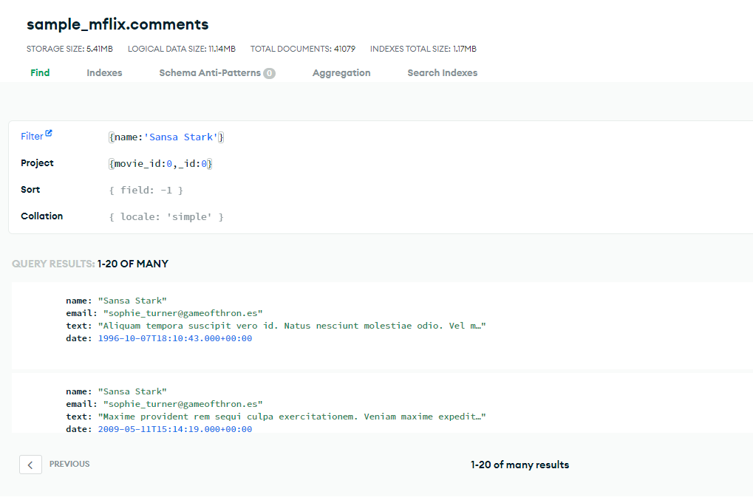

Slide 21
Lesson 12
Querying Data With Operators

Slide 22
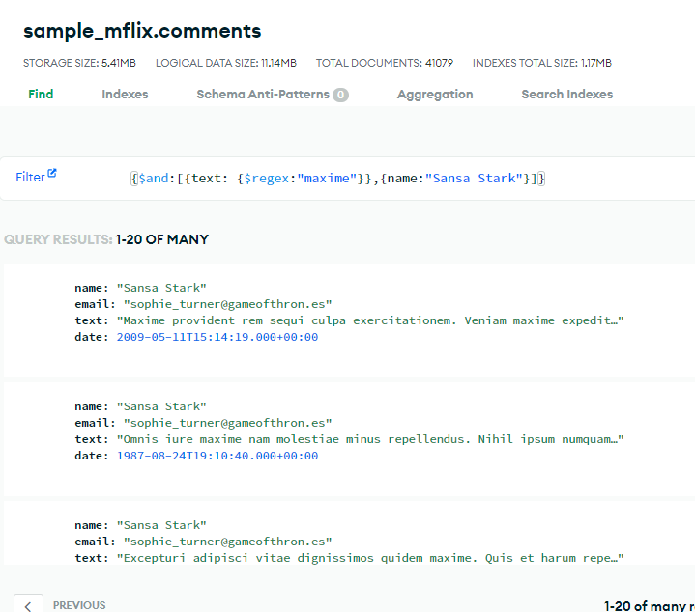
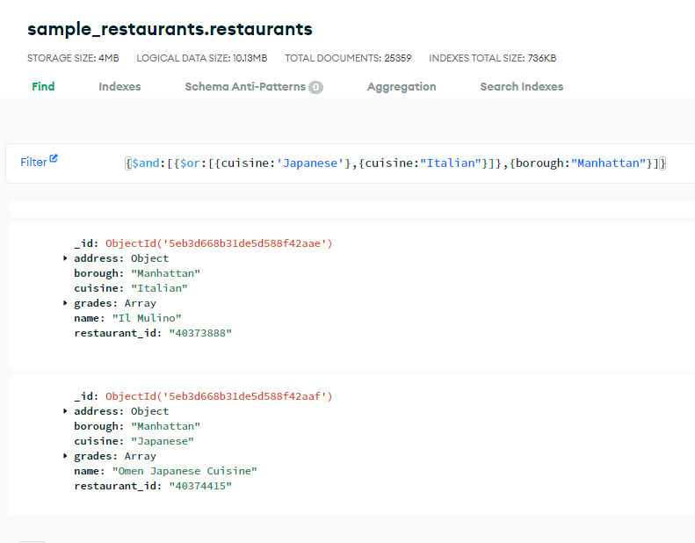
$and/$or

Slide 23
Aggregation Expressions
$expr operator allows the use of aggregation expressions in MQL { $expr: { <expression> } }
Expressions consist of field paths, literals, system variables, expression objects, and expression operators. These can be nested.
The $expr operator was introduced to allow MQL to take advantages of the wider range of query functionality built into the Aggregation framework.
Field paths are strings where the field name is prefixed by a dollar sign ($).
Useful for lookup embedded document fields
System variables, useful helpers such as NOW, ROOT, CLUSTER_TIME, etc.
"$$<variable>.<field>“
Literals can be of any type, they are used for values that you do not want parsed but rather interpreted as it is.
{ $literal: { $add: [ 2, 3 ] } }
Like functions and take arguments, typically these are an array of arguments:
{ <operator>: [ <argument1>, <argument2> ... ] }

Slide 24
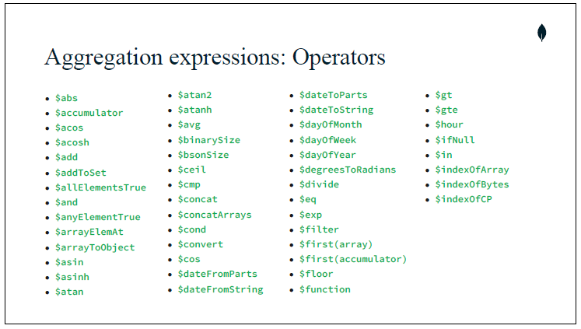

Slide 25
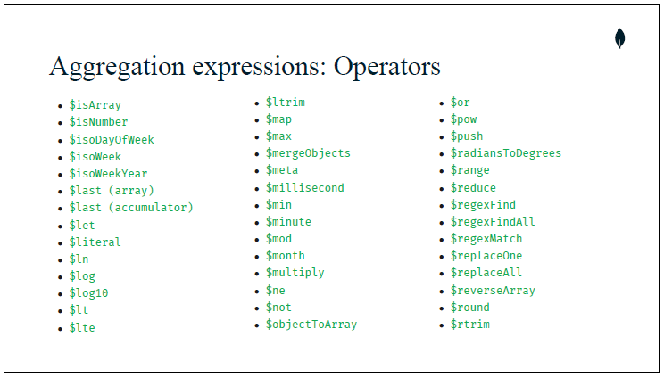

Slide 26
